Slide 1
HT-MFG2 Mold Equipment Budget Request
1
Cover sheet for equipment budget request (FAM Format)

Slide 2
HT-MFG2 Mold Equipment Budget Request
2
Cover sheet for equipment budget request (FAM Format)

Slide 3
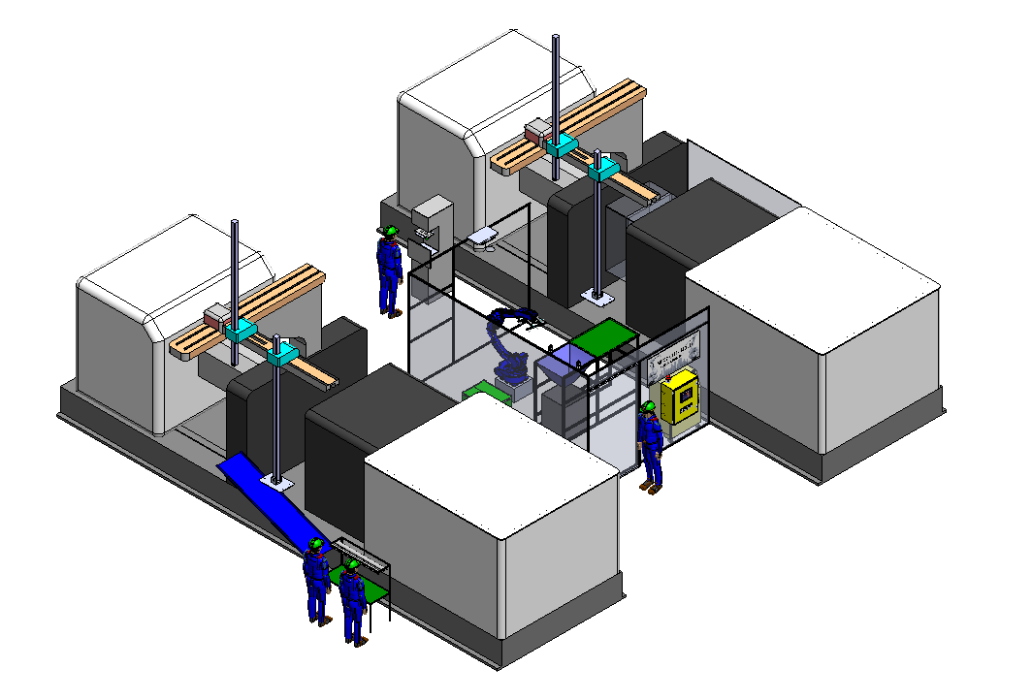
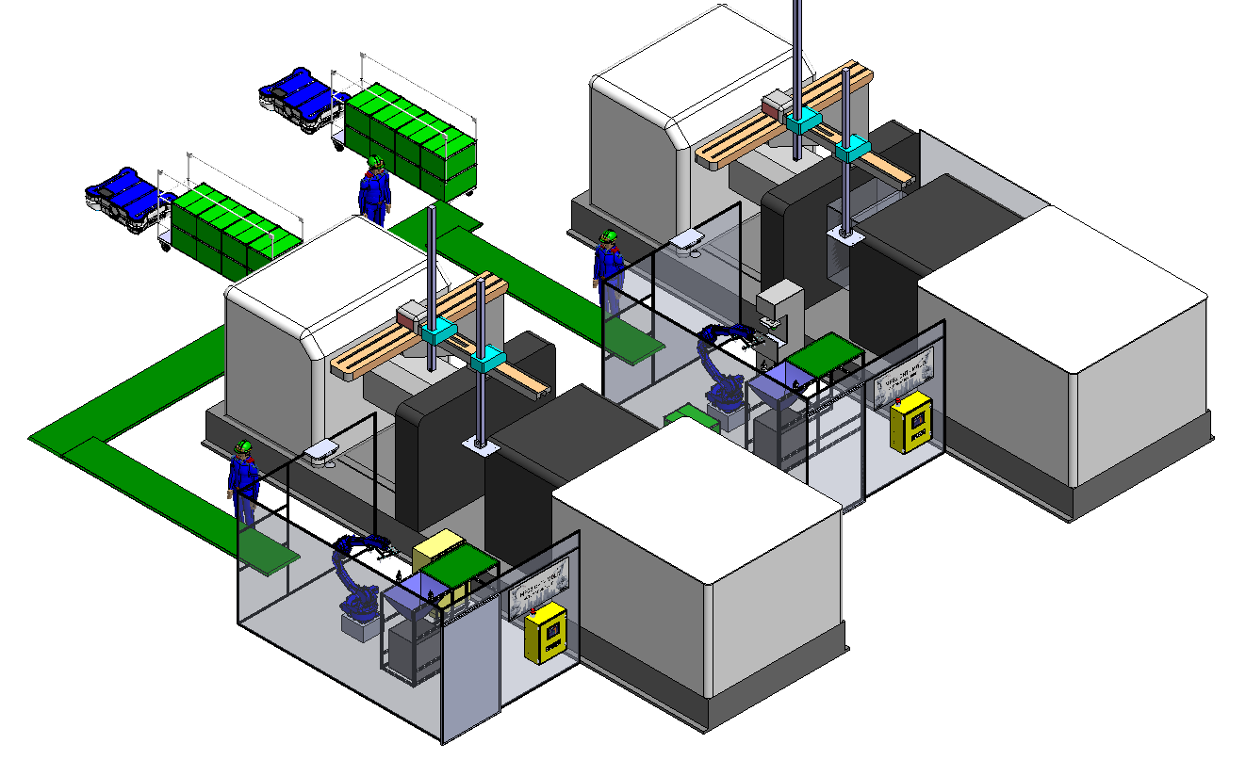
HT-MFG2 Mold Equipment Budget Request
3
ASSETS | OBJ. | BUDGET CODE | BUDGET NAME | W.C. | BUDGET (KB.) | ORDER
04 | 30 | 25ZZ04001 | Automation New | 3601 | 1,500 | 10/2025
■ Estimate Cost
Equipment Name |  | Estimate Cost (KB.)
 |  | Cost / u. | Q’TY | Total Cost
1 | Auto Cutting Unit | 90 | 2 | 180
2 | Camera Check Unit | 300 | 2 | 600
3 | Conveyor Unit | 80 | 2 | 160
4 | Electrical Equipment | 90 | 2 | 180
5 | Cover Unit | 60 | 2 | 120
6 | Gripper Robot | 40 | 2 | 80
Total Cost |  |  |  | 1,320
Project Name : Mold Auto-Production , Purpose : Cost Down (Sho-JIN / Ktsu-JIN)
Before
-Auto PAD
-Auto Camera CHK
Man-2
-Auto-Cutting Gate
Man-1
■ Ktasu-JIN , Sho-Jin
Process |  | Manpower (Person / Shift)
 |  | Before |  | After
 |  | 1001T | 1002T | 1001T | 1002T
1 | Cutting Gate | 1 | 1 | 0.7 Katsu-JIN =0.3 | 0.7 Katsu-JIN =0.3
2 | Cut Bari
3 | Cleaning Oil
4 | PAD Printing | 1 | 1
5 | Appearance Check |  |  | 1 (Sho-Jin = 1)
6 | Packing
Total |  | 4 |  | 1.4
Reduce Manpower = 1.6 Person / Shift Total 2 Shift = 3.2 Person
Man-4
Man-3
Auto Set #1.
Support production 2 parts
After
Man-3
-Auto AGV
Man-1
-Auto Camera CHK
-Auto-Cutting Gate
-Auto PAD
Man-2
3.Add Conveyor u.
Combine
2 MC.
-Auto-Cutting Gate
-Auto PAD
-Auto Camera CHK
1.Modify Auto Set #1.
to cover all part
■ Estimate ROI
1,440 KB. / 3.2 P. x 235 KB. = 1.95 Year (23months)
2.Add Auto Set #2.
Notes:
เนื่องจากในปีนี้ ทางMFG2 Mold มีแผนการทำProject Full Auto Production
โดยมีเป้าหมายที่เครื่องฉีด1001T
มีProcessการทำงานหลัก 4 ขั้นตอน
Cutting Gate
PAD Printing
Appearance Check
Packing

Slide 4
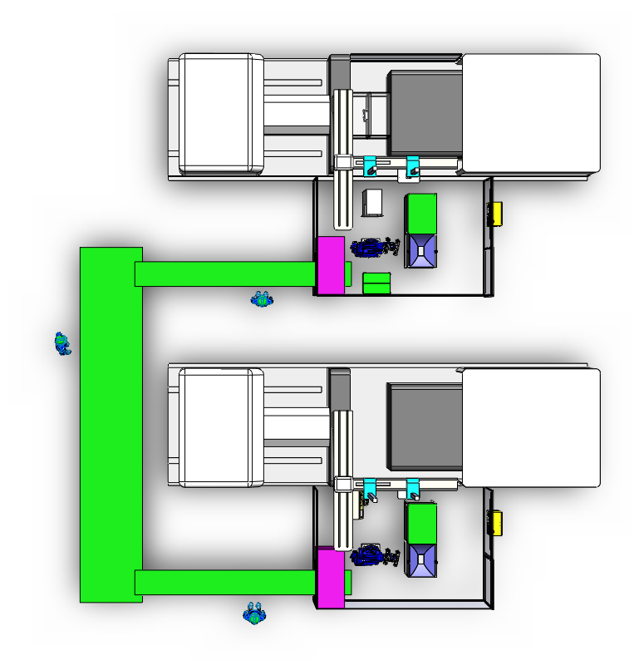
HT-MFG2 Mold Equipment Budget Request
4
ทำFlowให้เข้าใจเส้นทางของPartและการทำงานของเครื่อง คน Robot
Automation Concept.
PAD
Auto Cut Gate
CAMERA CHECK
ROBOT
Auto Cut Gate
CAMERA CHECK
ROBOT

Slide 5
HT-MFG2 Mold Equipment Budget Request
5
แยกข้อมูลแต่ละUnitให้เข้าใจถึงการออกแบบ การทำงาน ความสามารถ และEquipmentที่ต้องการ (ทุก Unit)
Camera Check Concept.
1. Appearance Guarantee Items / Spec.
3. Camera check design concept
2. Equipment SPEC Requirement
4. Equipment cost / order preparation
-Quotation …
2. Camera Unit
Equipment Name |  | Estimate Cost (KB.)
 |  | Cost | Q’TY | Total Cost
1 | Camera (IV 4 KEYENCE) | 110 | 3 | 330
2 | Structure and Cover | 30 | 1 | 30
Total Cost |  |  |  | 360

Slide 6
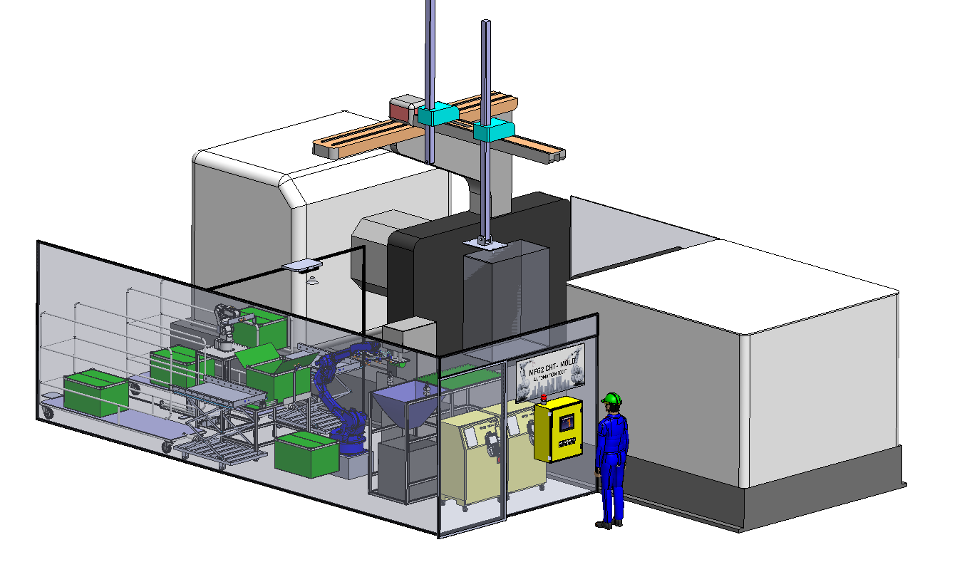
HT-MFG2 Mold Equipment Budget Request
6
Detail : Equipment for Unit in Projection Auto Production Step 2
1. Auto Cutting Unit
Equipment Name |  | Estimate Cost (KB.)
 |  | Cost | Q’TY | Total Cost
1 | Air Nipper | 20 | 2 | 40
2 | Sensor Check | 15 | 2 | 30
3 | Solenoid Valve | 3 | 3 | 9
4 | Structure and Cover | 11 | 1 | 11
Total Cost |  |  |  | 90
4. Electrical Equipment
Equipment Name |  | Estimate Cost (KB.)
 |  | Cost | Q’TY | Total Cost
1 | Box Control | 13 | 1 | 13
2 | PLC MELSEC-F FX3S | 40 | 1 | 40
3 | GOT2000 Series GT21 | 27 | 1 | 27
4 | Power Support | 10 | 1 | 10
Total Cost |  |  |  | 90
Man-3
Man-1
-Auto Camera CHK
-Auto AGV
-Auto-Cutting Gate
-Auto PAD
Man-2
3.Add Conveyor u.
Combine
2 MC.
-Auto-Cutting Gate
-Auto PAD
2. Camera Unit
Equipment Name |  | Estimate Cost (KB.)
 |  | Cost | Q’TY | Total Cost
1 | Camera (IV 4 KEYENCE) | 110 | 3 | 330
2 | Structure and Cover | 30 | 1 | 30
Total Cost |  |  |  | 360
5. Cover Unit
Equipment Name |  | Estimate Cost (KB.)
 |  | Cost | Q’TY | Total Cost
1 | Area Sensor | 40 | 1 | 40
2 | Structure and Cover | 20 | 1 | 20
Total Cost |  |  |  | 60
-Auto Camera CHK
1.Modify Auto Set #1.
to cover all part
2.Add Auto Set #2.
Detail Show Cost for Unit by Unit
Sum Detail Unit for 1 Machine Cost = 720 KB.
For Project Auto Production use 2 Machine Cost =1440 KB.
3. Conveyor Unit
Equipment Name |  | Estimate Cost (KB.)
 |  | Cost | Q’TY | Total Cost
1 | AC Motor | 5 | 4 | 20
2 | Belt Conveyor | 10 | 4 | 40
3 | Structure Conveyor | 20 | 1 | 20
Total Cost |  |  |  | 80
6. Gripper Robot
Equipment Name |  | Estimate Cost (KB.)
 |  | Cost | Q’TY | Total Cost
1 | Cylinder Gipper | 35 | 1 | 35
2 | Structure and Cover | 5 | 1 | 5
Total Cost |  |  |  | 40
Conveyor Unit
Conveyor Unit
Camera Unit
Robot
2.Auto-PAD Printing
3.Auto-Appearance CHK by Camera
4.Auto-Packing by Robot
1.Auto-Cutting Gate
Notes:
เนื่องจากในปีนี้ ทางMFG2 Mold มีแผนการทำProject Full Auto Production
โดยมีเป้าหมายที่เครื่องฉีด1001T
มีProcessการทำงานหลัก 4 ขั้นตอน
Cutting Gate
PAD Printing
Appearance Check
Packing

Slide 7
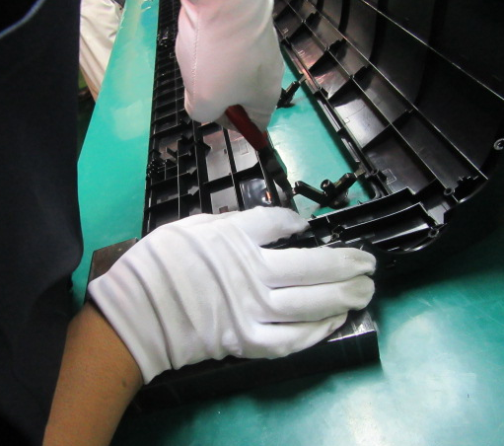
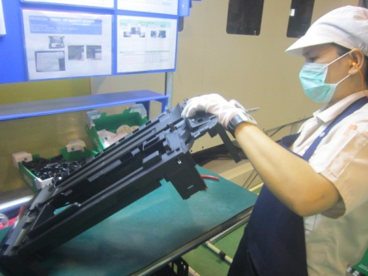
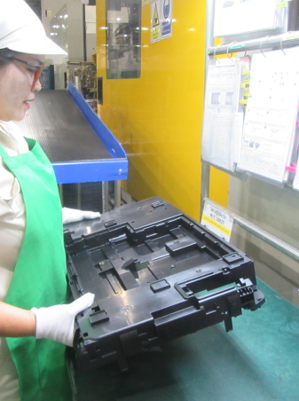
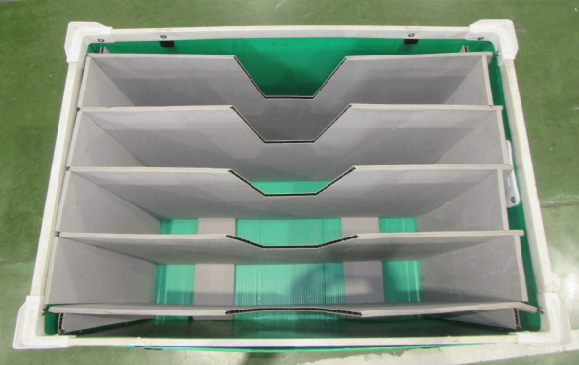
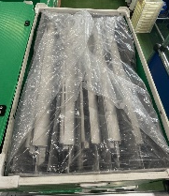
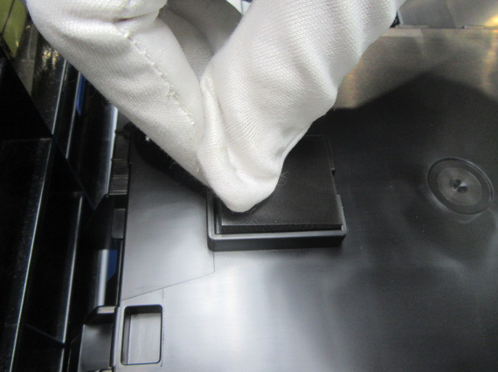
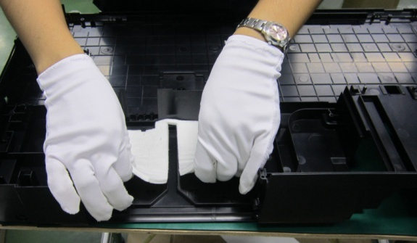
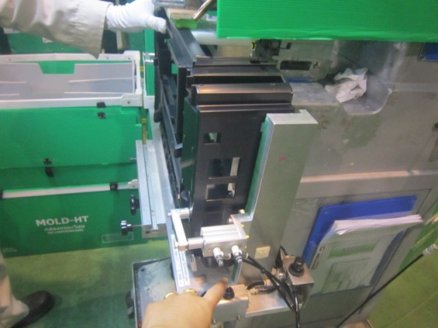
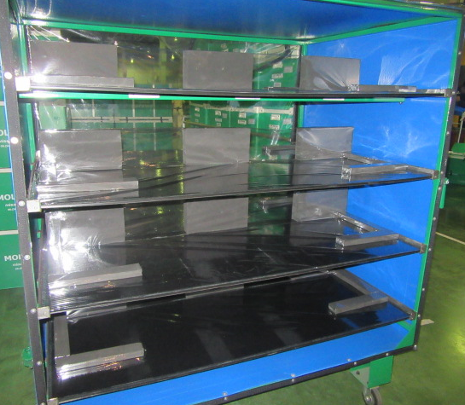
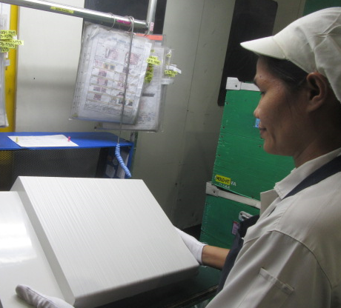
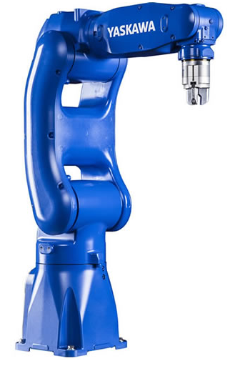

HT-MFG2 Mold Equipment Budget Request
7
Part Injection 1001T and 1002T
Compare Process for New Process Add Robot
Process Part All 10 Process
Cutting gate | Wipe off oil stains | Cut Bari | BOX | Box (มีถุงด้านใน) | Assembly Rubber Foot | Drain Sheet | PAD | Rack | Confirm Part
New Process (ROBOT / OPERATOR)
Camera
Camera
Camera

Slide 8
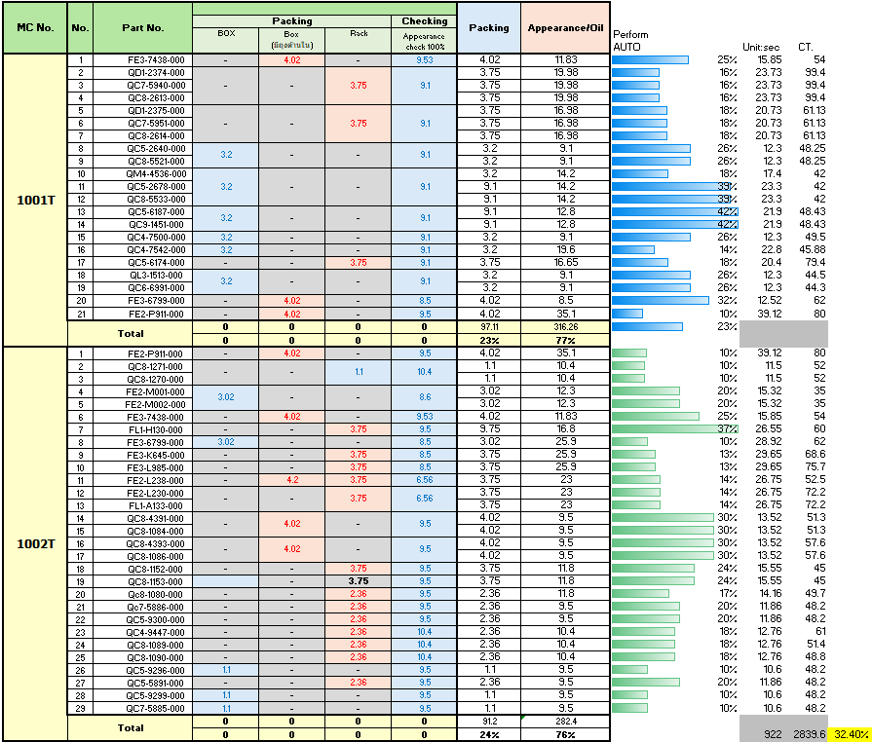
HT-MFG2 Mold Equipment Budget Request
8
Summary Process Time of 1001T , 1002T
Detail Compare Time Operator at Cannot use Robot

Slide 9
HT-MFG2 Mold Equipment Budget Request
9
Full auto Production Step 2
Action Plan / Schedule
Action plan process |  | 2025 |  |  |  |  | 2026
 |  | Aug | Sep | Oct | Nov | Dec | Jan | Feb | Mar | Apr | May | Jun | Jul
Design 3D | Plan
 | Actual
Request Equipment Budget | Plan
 | Actual
Order part | Plan
 | Actual
Making | Plan
 | Actual
Debug | Plan
 | Actual
Input MP | Plan
 | Actual
Notes:
Action plan

Slide 10
Appendix

Slide 11
HT-MFG2 Mold Equipment Budget Request
11
ทำFlowให้เข้าใจเส้นทางของPartและการทำงานของเครื่อง คน Robot
Automation Concept.
Auto PAD
Camera
Robot
Auto
Cut
gate
CTRL Box

Slide 12
HT-MFG2 Mold Equipment Budget Request
12
แยกข้อมูลแต่ละUnitให้เข้าใจถึงการออกแบบ การทำงาน ความสามารถ และEquipmentที่ต้องการ (ทุก Unit)
Camera Check Concept.
1. Appearance Guarantee Items / Spec.
3. Camera check design concept
2. Equipment SPEC Requirement
4. Equipment cost / order preparation
-Quotation …
2. Camera Unit
Equipment Name |  | Estimate Cost (KB.)
 |  | Cost | Q’TY | Total Cost
1 | Camera (IV 4 KEYENCE) | 110 | 3 | 330
2 | Structure and Cover | 30 | 1 | 30
Total Cost |  |  |  | 360

Slide 13
 |  |  |  |  | Planner | Production | Qa
No | M / C | Mold Master | Part no |  | Lot size | Man power | Point bari
1 | 1001J | QC8-1089 |  |  | 1 | 1 | 0
2 | 1001J | QC8-1090 |  |  | 2 | 1 | 0
3 | 1001J | QC8-1084 |  |  | 1 | 1 | 2
4 | 1001J | QC8-1086 |  |  | 1 | 1 | 1 (ใย Bari)
5 | 1001J | QC4-7500 |  |  | 1 | 2 | 0
6 | 1001J | QC4-7542 |  |  | 1 | 2 | 0
7 | 1001J | QC6-6991 | QL3-1513(ประกอบdrain sheet&Ruber foot) |  | 1 | 1 | 1
8 | 1001J | QC5-2640 | QC8-5521(change mat'l) |  | 4 | 1 | 1
9 | 1001J | QC5-2678 | QC8-5533 | QM4-4536 | 4 | 1 | 0
10 | 1001J | QC5-6187 | QC9-4151 |  | 5 | 1 | 0
11 | 1001J | QD1-2374 | QC8-2613 | QC7-5940 | 5 | 2 | 4
12 | 1001J | QD1-2375 | QC8-2614 | QC7-5951 | 5 | 2 | 5
13 | 1001J | QD1-2358 | QC8-2547 |  | 3 | 1 | 3
14 | 1001J | QD1-2366 | QC8-2578 |  | 3 | 1 | 0
15 | 1001J | QC5-6174 |  |  | 7 | 2 | 0
16 | 1001J | QC5-9312 |  |  | 30 | 1 | 0
17 | 1001J | QC5-9313 |  |  | 30 | 1 | 0
18 | 1001J | QC5-9301 |  |  | 30 | 1 | 0
19 | 1001J | QC5-9302 |  |  | 30 | 1 | 0
20 | 1002J | FE2-P911 |  |  | 1 | 2 | 14
21 | 1002J | FE3-6799 |  |  | 2 | 2 | 9
22 | 1002J | FE3-K645 |  |  | 15 | 2 | 0
23 | 1002J | FE3-L985 |  |  | 15 | 2 | 0
24 | 1002J | FE2-L238 |  |  | 3 | 2 | 1
25 | 1002J | FE3-7438 |  |  | 3 | 2 | 3
26 | 1002J | FE2-N591 | FL1-H130 |  | 5 | 2 | 9
27 | 1002J | FE2-L230 | FL1-A133 |  | 5 | 2 | 0
28 | 1002J | QC8-4391 | QC8-1084(change mat'l) |  | 15 | 2 | 2
29 | 1002J | QC8-4393 | QC8-1086(change mat'l) |  | 15 | 2 | 1
30 | 1002J | FE2-M001/M002 |  |  | 5 | 2 | 0/0
31 | 1002J | QC8-1080 |  |  | 1 | 2 | 0
32 | 1002J | QC8-1152 |  |  | 1 | 2 | 3
33 | 1002J | QC8-1153 |  |  | 2 | 2 | 2 (ใย bari)
34 | 1002J | QC4-9176 | QC8-1270(change mat'l) |  | 30 | 2 | 0
35 | 1002J | QC4-9447 | QC8-1271(change mat'l) |  | 30 | 2 | 0
36 | 1002J | QC5-9299 | QC7-5885 (Change Mat’l) |  | 30 | 2 | 0
37 | 1002J | QC5-9300 | QC7-5886(change mat'l) |  | 30 | 2 | 0
38 | 1002J | QC5-9296 | QC7-5891(change mat'l) |  | 30 | 2 | 0
Lot Size
1 = Run ทุกวัน
2 = วันเว้นวัน
3 = 3 Run 1 ครั้ง
4 = 4 Run 1 ครั้ง
5 = 5 Run 1 ครั้ง
7 = 7 Run 1 ครั้ง
15 = 4 Run 1 ครั้ง
30 = 4 Run 1 ครั้ง

